Slide 1






Power BI & Dynamics 365
Highlight The Value of Dynamics Biz Apps With Analytics
Notes:
As an implementer/architect I often wrestled with getting the business decision makers to embrace the value of the information being accumulated and processed within Dynamics.
The sales data and the nuance of how service cases are handled – there’s gold in that data, if only we could take exploit it.
In the last few years, PowerBI has exploded onto the data visualization and analytics scene and I believe it can serve as an accelerant on the BDM Conversations we have with prospects – and with long time users who are looking at expanding or re-evaluating Dynamics as a Business Application platform.

Slide 2
Engage Business Decision Makers with Dynamics 365 Analytics
The objective is to sell the value of Dynamics
Analytics is more than Pie Charts and Graphs
Analytics captures the imagination of the BDM
PowerBI gives US an unfair advantage
Notes:
Selling PowerBI might be a virtuous Side Effect, but Selling Dynamics is the Focus of our Conversation
PowerBI is crushing the competition and it’s crazy to not use it – It’s like an Ace or a Draw-Four card – use it!
We have visuals within Dynamics – they are great for end-users, but BDMs / Managers / Business Analysts need more
The visuals and intelligence built into PowerBI engage the imagination of BDMs
( Let’s face it, BDMs don’t care how many clicks it takes to get to the center of an opportunity; this appeals to their needs.)

Slide 3

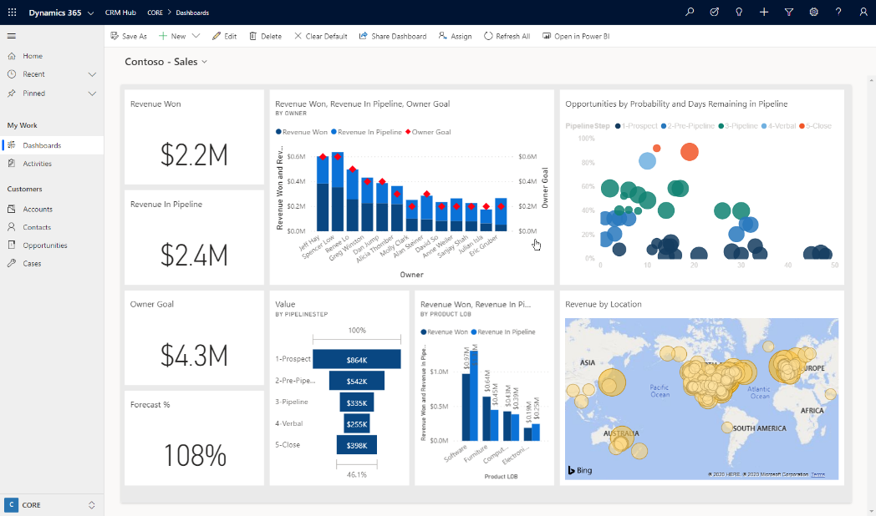
Show Me
Interactive Visualizations
What-If Exploration
No Code AI
Ask Questions, Get Answers
KPIs and Time Series Charts
Analytics on Entity forms
Notes:
Let’s look at several features of showing PowerBI within Dynamics that help engage and delight our Business Decision Makers.
I have six Themes I want to show you that are examples of how PowerBI can engage the decision makers, managers and leaders in a business to view Dynamics / CDS as their best choice for a Business Application Platform.
But the first and most obvious thing is one of the simplest, see how the dashboard is a seamless part of the Dynamics UI – In fact occasionally I’ll go through a demo and only later in the conversation to I refer to PowerBI as a part of the Microsoft Business Applications Platform.
Clicking on the dashboard allows us to drill into the underlying report - <Click>

Slide 4
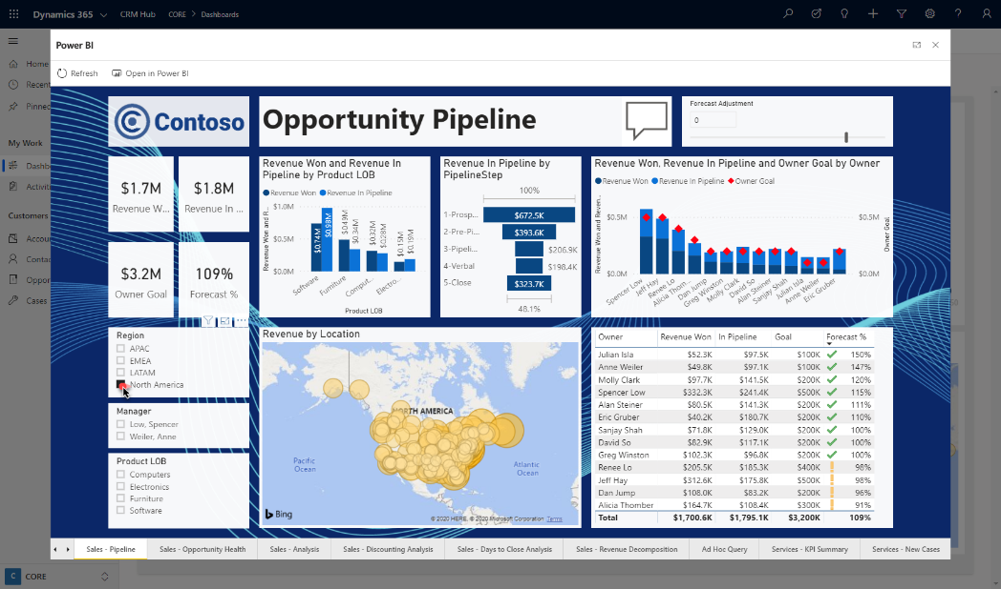
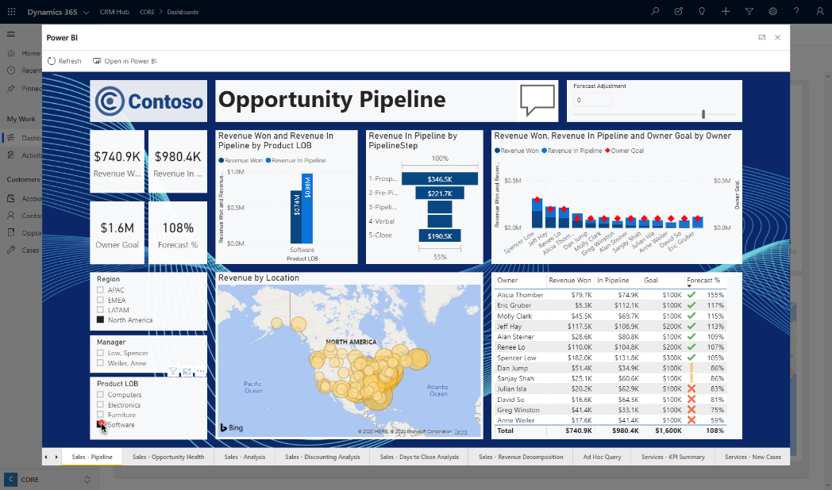
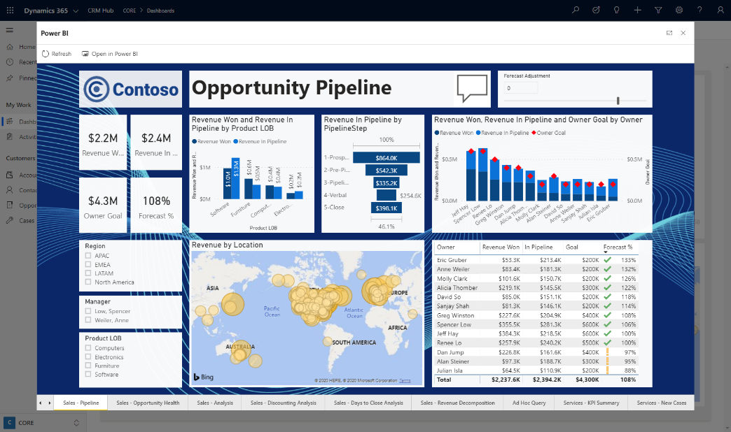
Show Me
Interactive Visualizations
What-If Exploration
No Code AI
Ask Questions, Get Answers
KPIs and Time Series Charts
Analytics on Entity forms
Notes:
Probably everyone on the call has interacted with a PowerBI dashboard – and seen the filtering and cross-highlighting <Click>
If the data model is built out to resemble CDS, we can filter on a Region and see the rest of the report, such as the maps or charts, respond. <Click>
The interaction can be tailored to the conversation/purpose – but ultimately, it’s a way for BDMs to start at the high-level and drill down to the details for more understanding. <Click>

Slide 5
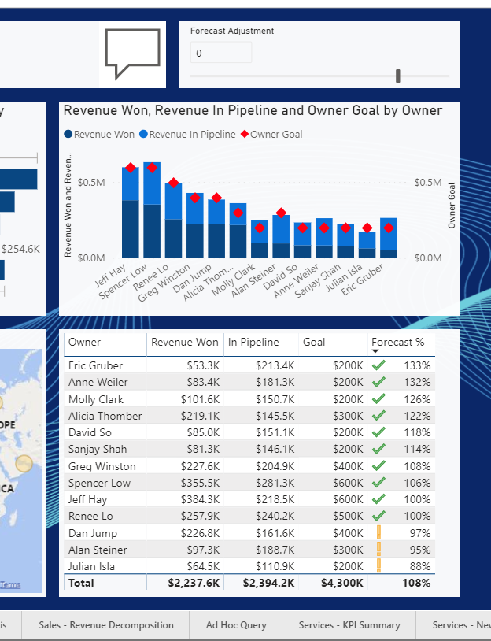
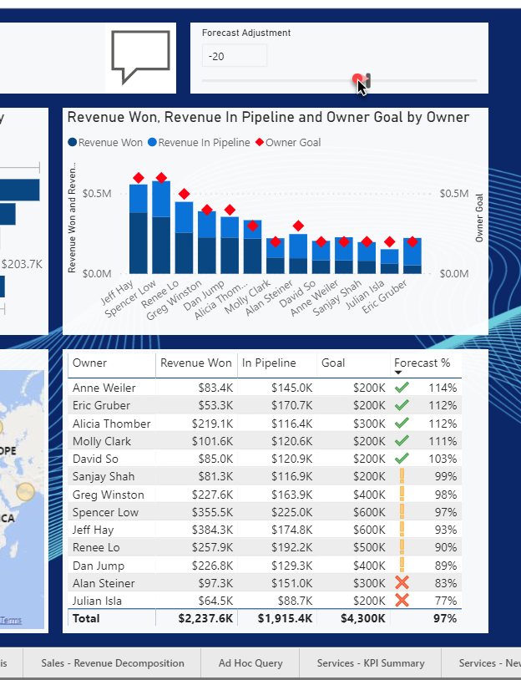
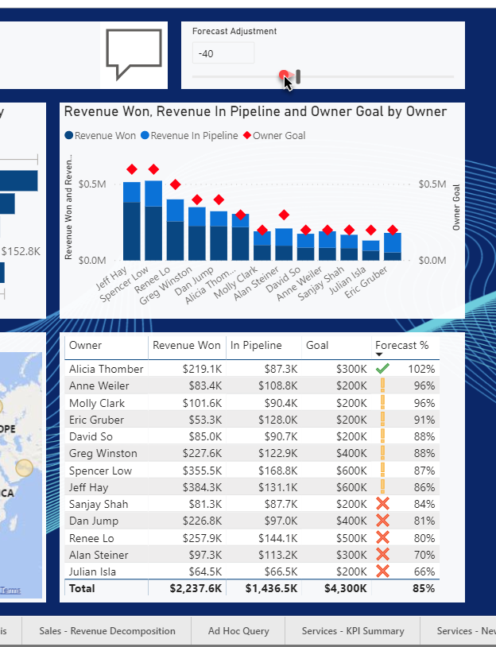

Show Me
Interactive Visualizations
What-If Exploration
No Code AI
Ask Questions, Get Answers
KPIs and Time Series Charts
Analytics on Entity forms
Notes:
Take a look at the right side of the screen, <Click>
There’s Actual and Forecasted Revenue, by owner, along with their Goals in Sales Pipeline – I’ll Zoom in now - <Click>
At the Top of the area, <Click> There’s a Forecast Adjustment Slider – A manager can interactively adjust one value <Click> (in this case an estimate of how much of the forecasted pipeline they want to assume will close)
As they adjust it, the chart and table respond – <Click>
You can see how as we lower our forecast expectations by 40%, <Click>
more users show up with a warning or a red X –meaning they are at risk of not making quota unless they beat expectations.

Slide 6
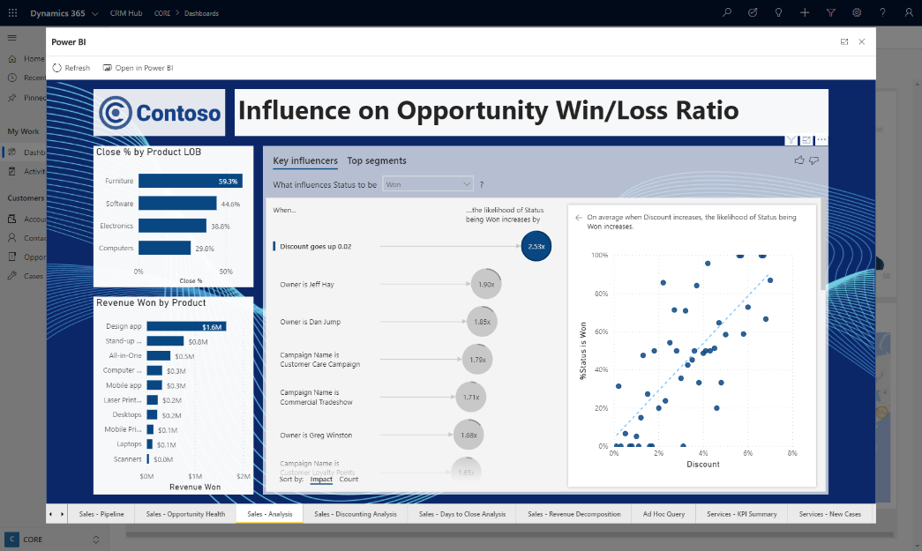
Show Me
Which Factors Influence an outcome and what is the Relative Impact of each Factor?
Salesperson
Interactive Visualizations
What-If Exploration
No Code AI – Key Influencer
Ask Questions, Get Answers
KPIs and Time Series Charts
Analytics on Entity forms
Product
Discounting
Industry
Competitor
Notes:
Business Decision Makers need the insights into what factors drive a particular outcome they measure – such as opportunity close or customer satisfaction <Click>
Think of any opportunity you’ve worked – <Click>
There are tons of factors that influence whether opportunities are Won or Lost – Salesperson, Product, Pricing, Industry, Competitor, etc. – But an objective look at WHICH factor makes the most significant impact over a wide range of opportunities requires a statistical tool called ‘regression analysis’ (and probably not a few Excedrin and Coffees.)

Slide 7
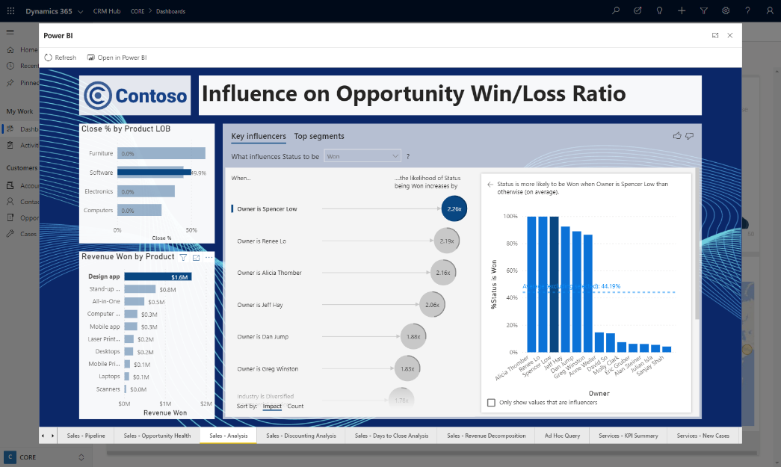
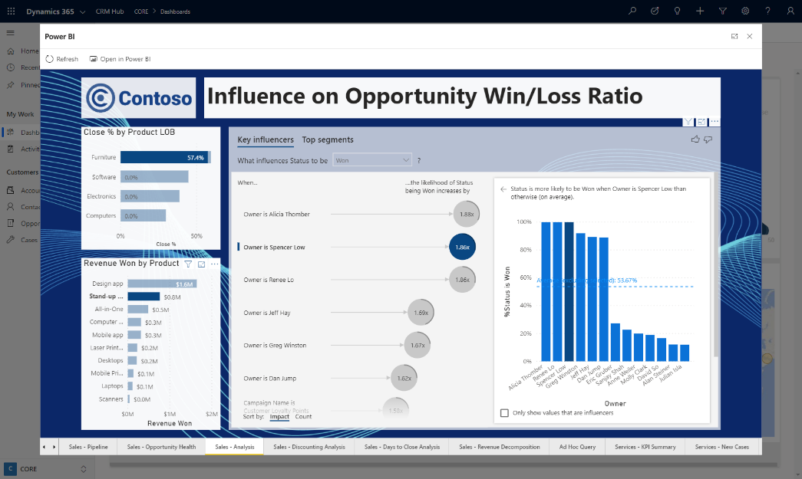
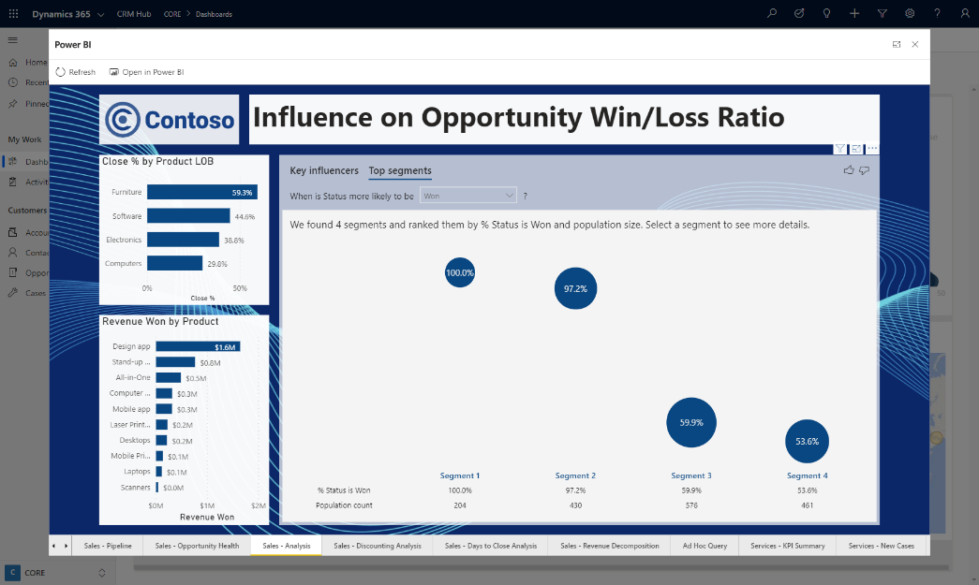
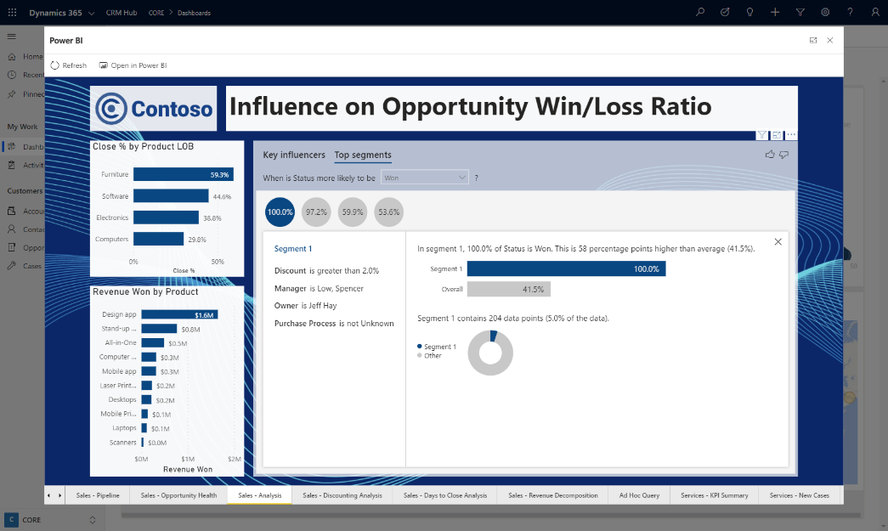
Show Me
Interactive Visualizations
What-If Exploration
No Code AI – Key Influencer
Ask Questions, Get Answers
KPIs and Time Series Charts
Analytics on Entity forms
Notes:
Here we see that overall, Discounting is driving a 2x increase in sales success for each 2% it increases overall across products – but we see that in context of other factors.
But if we drill into a single product, <click> - We see different factors are more influential on that product, however <click> other products have a different combination of factors.
<click> We can also see ‘clusters’ of factors that influence sales success across the pipeline.
<Click> -

Slide 8
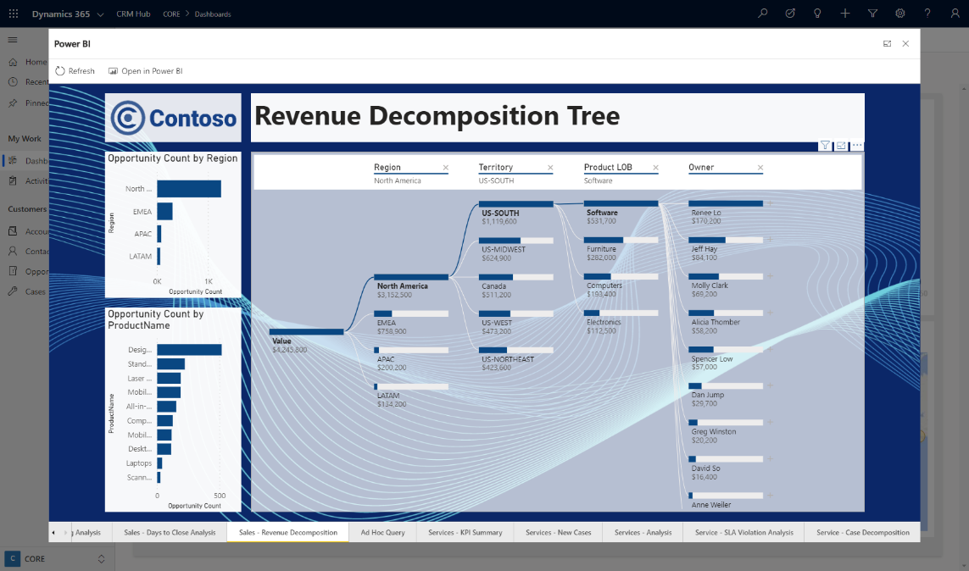
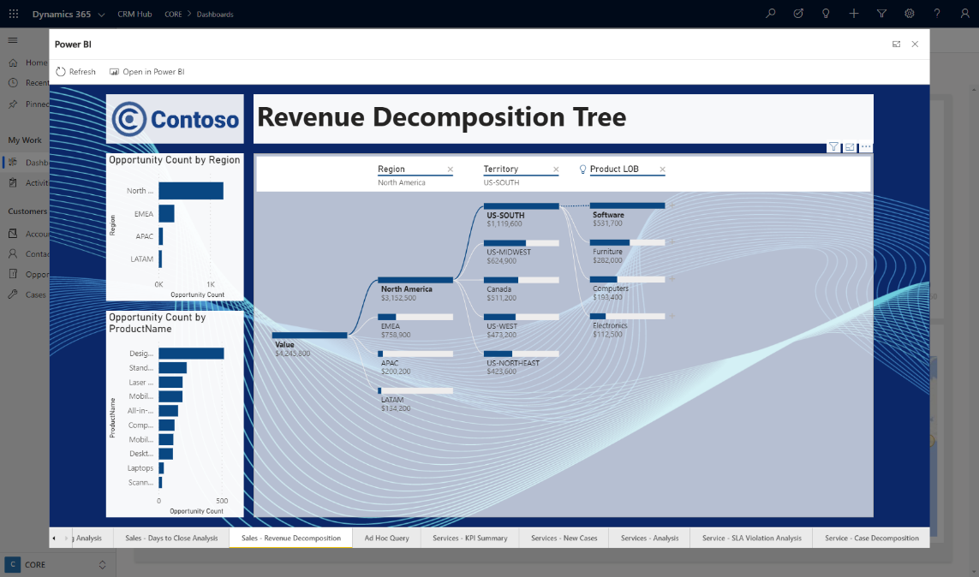
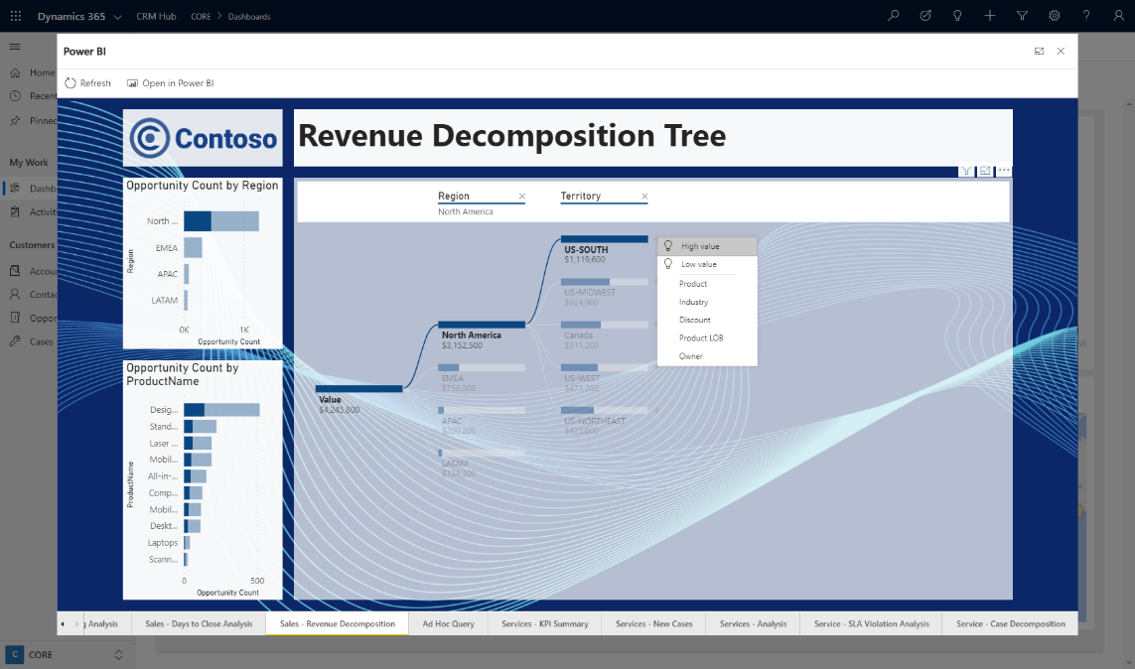
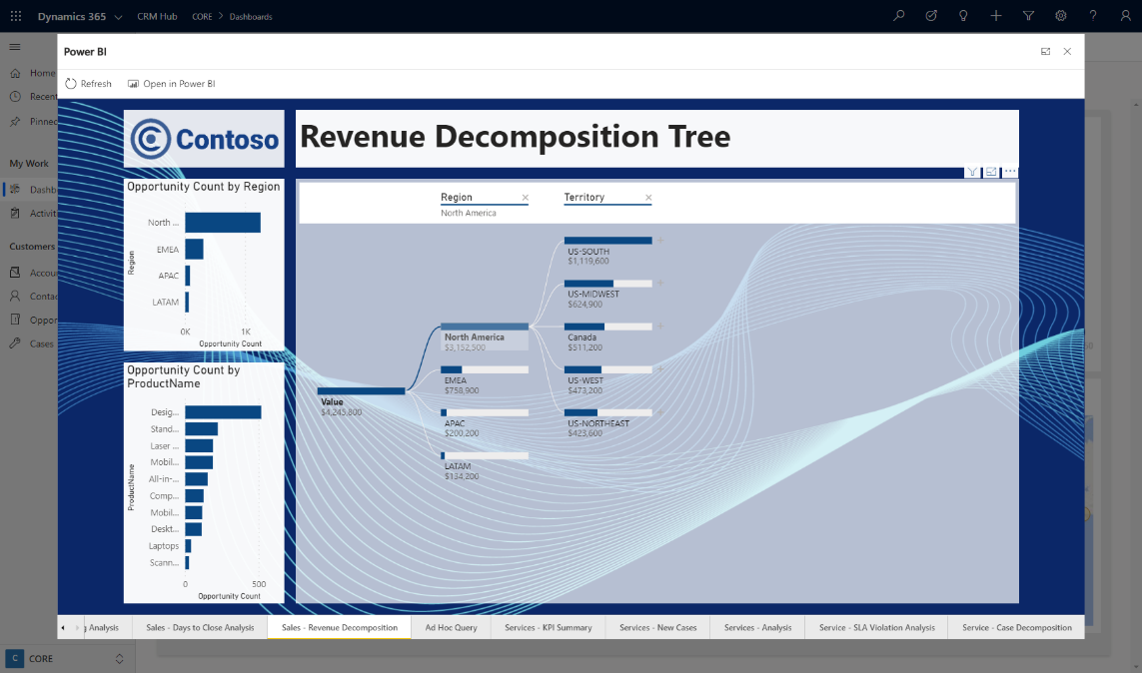
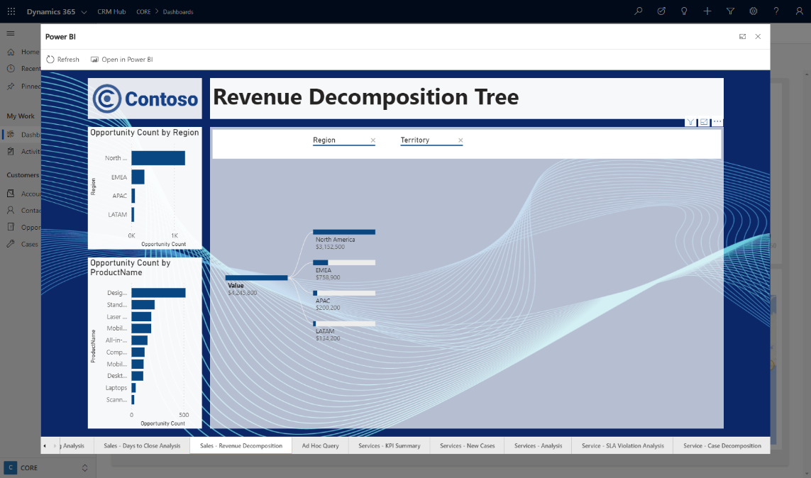
Show Me
Interactive Visualizations
What-If Exploration
No Code AI – Decomp Tree
Ask Questions, Get Answers
KPIs and Time Series Charts
Analytics on Entity forms

Slide 9
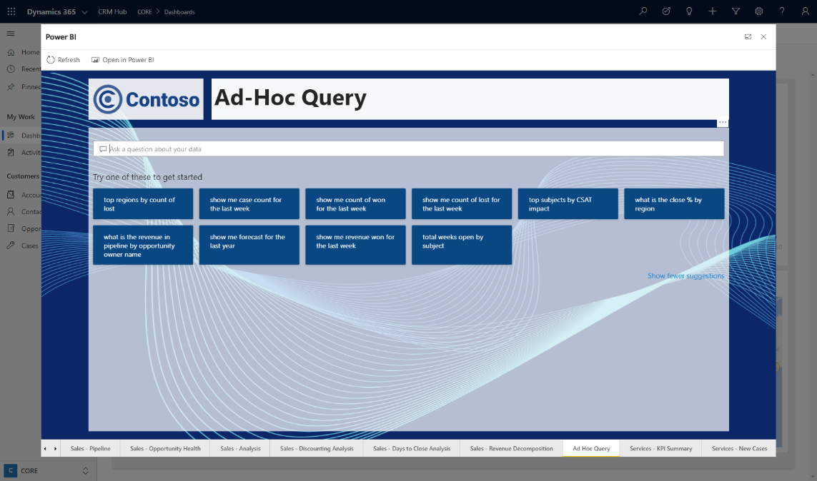
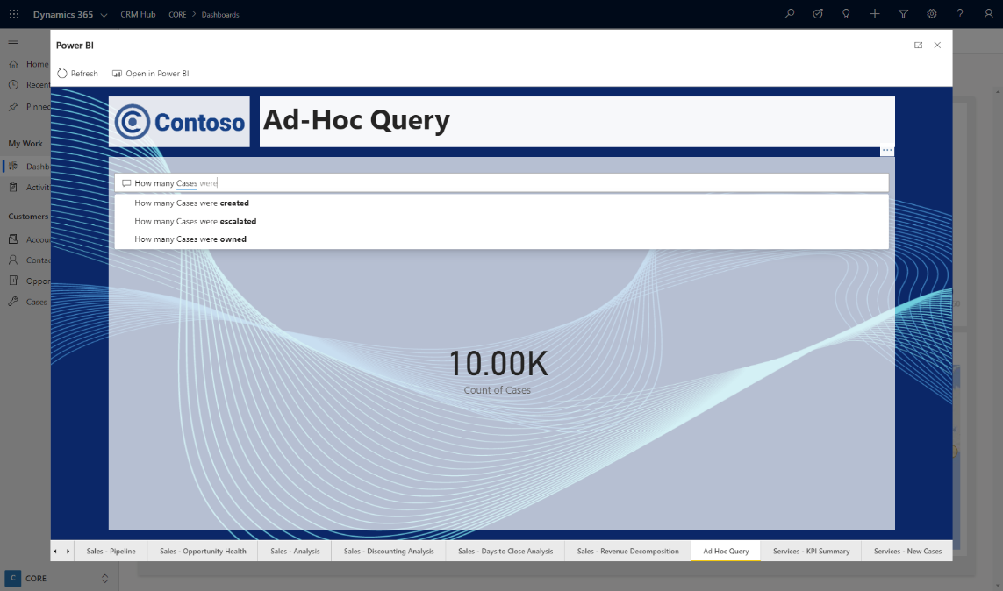
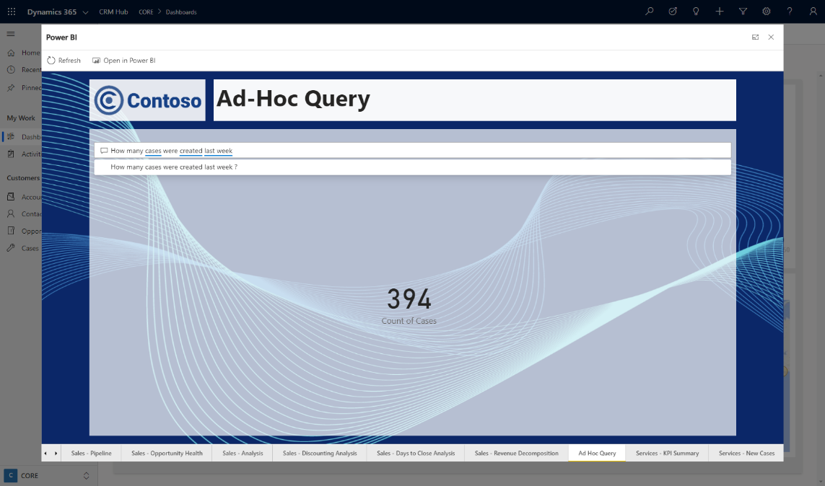
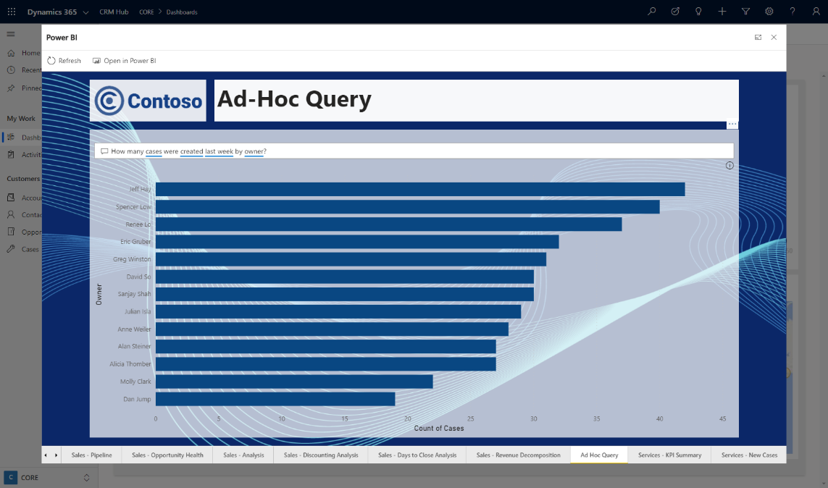
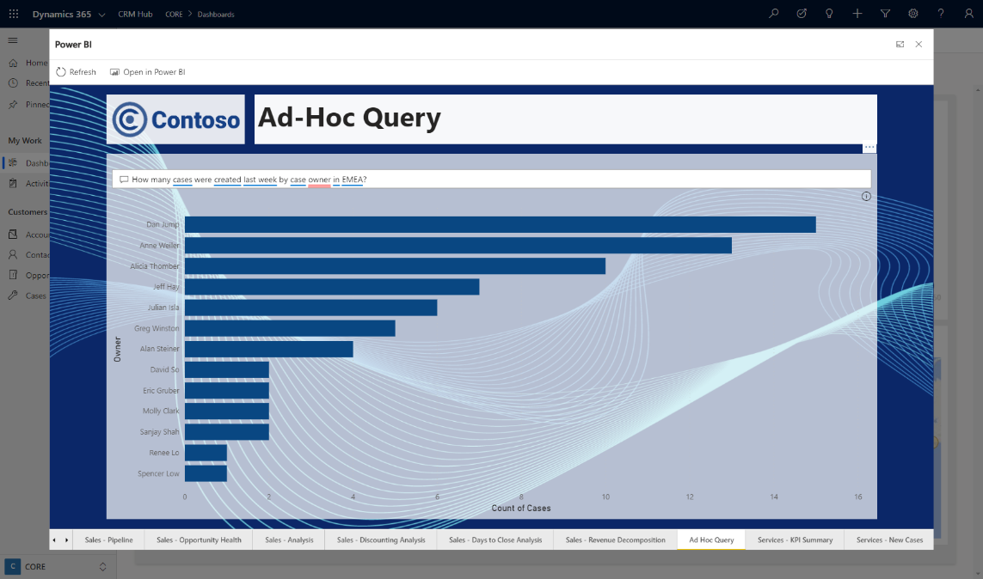
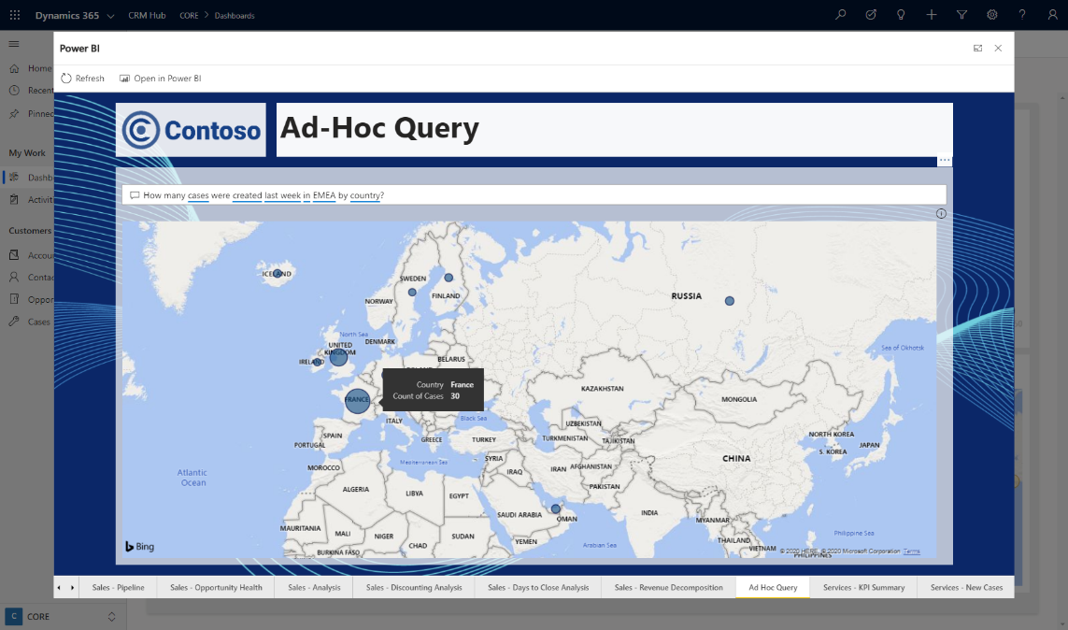
Show Me
Interactive Visualizations
What-If Exploration
No Code AI
Ask Questions, Get Answers
KPIs and Time Series Charts
Analytics on Entity forms

Slide 10
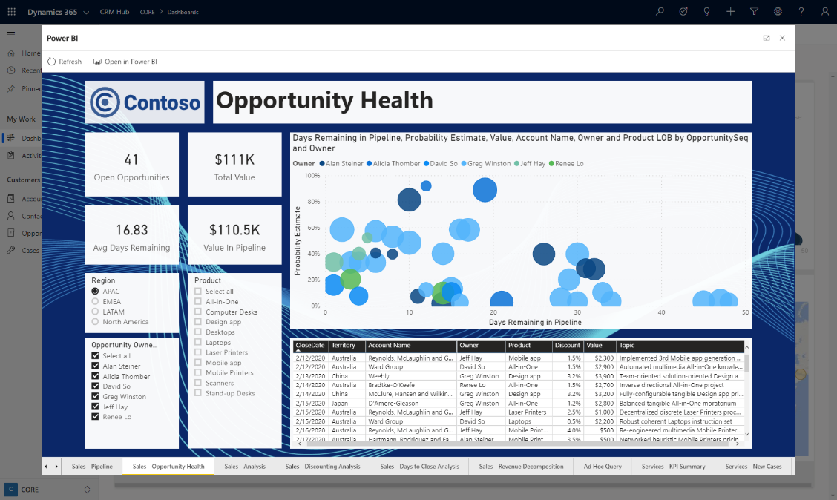
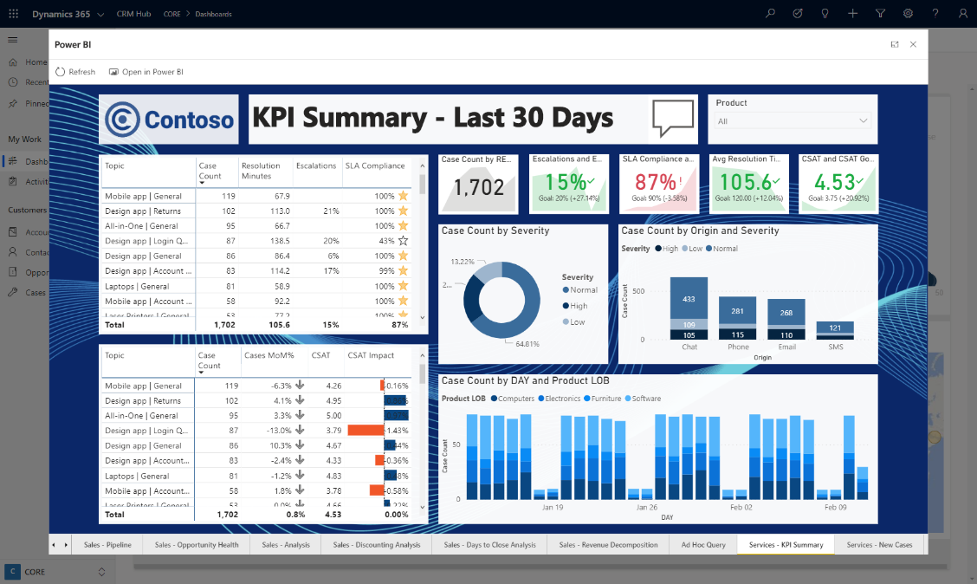
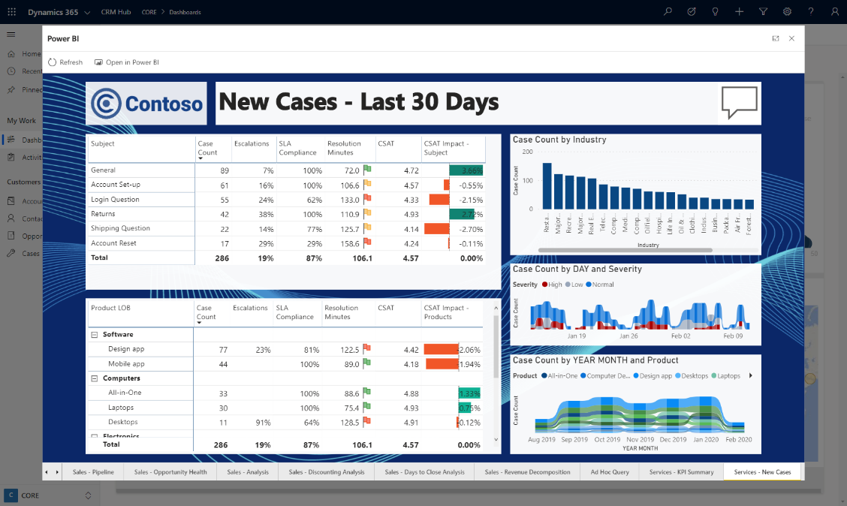
Show Me
Interactive Visualizations
What-If Exploration
No Code AI
Ask Questions, Get Answers
KPIs and Time Series Charts
Analytics on Entity forms

Slide 11
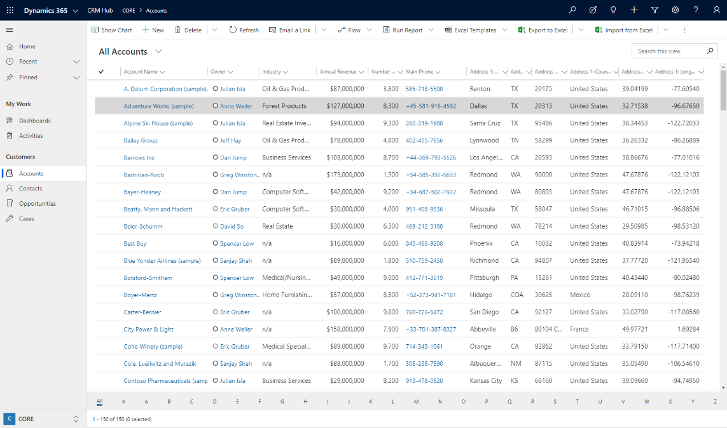
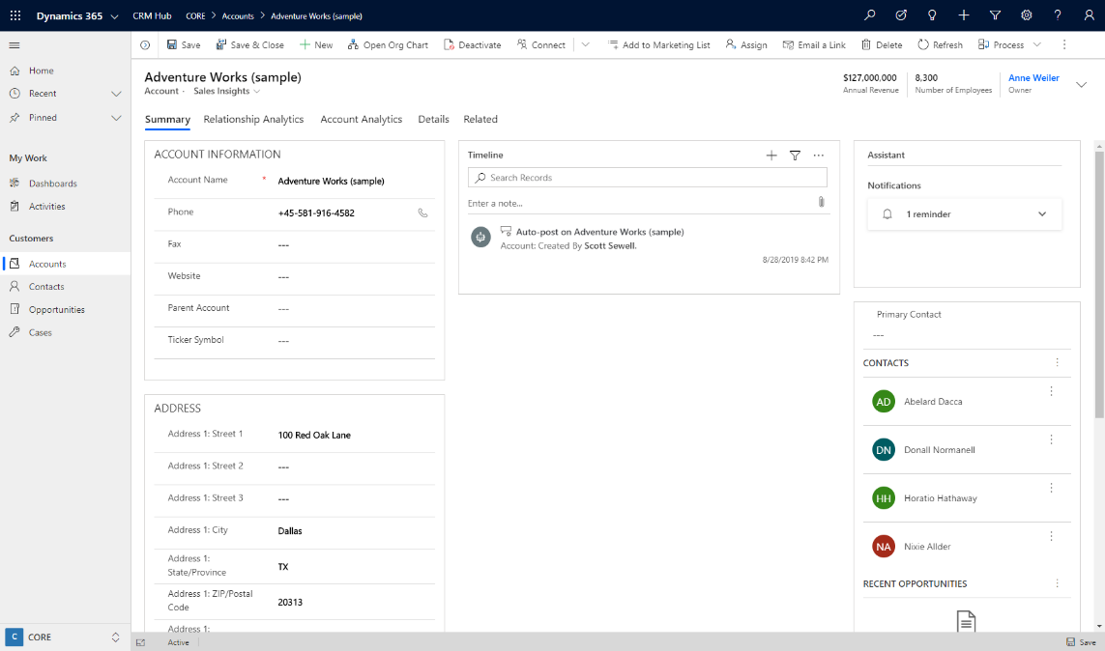
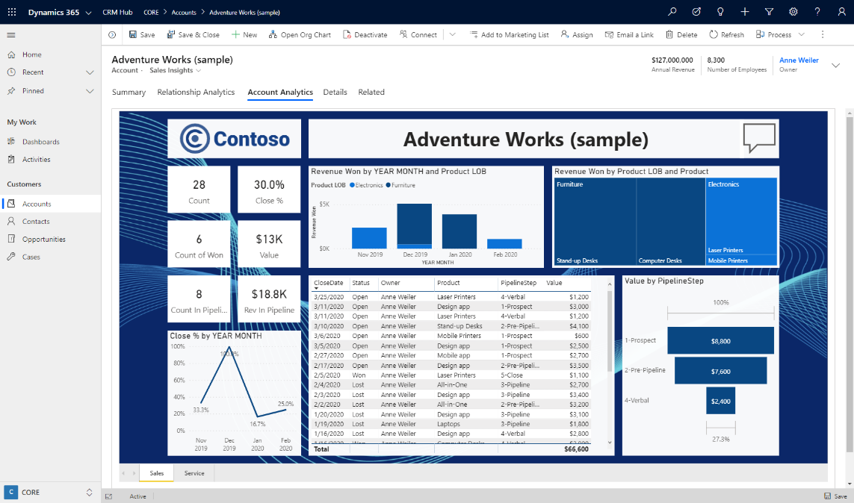
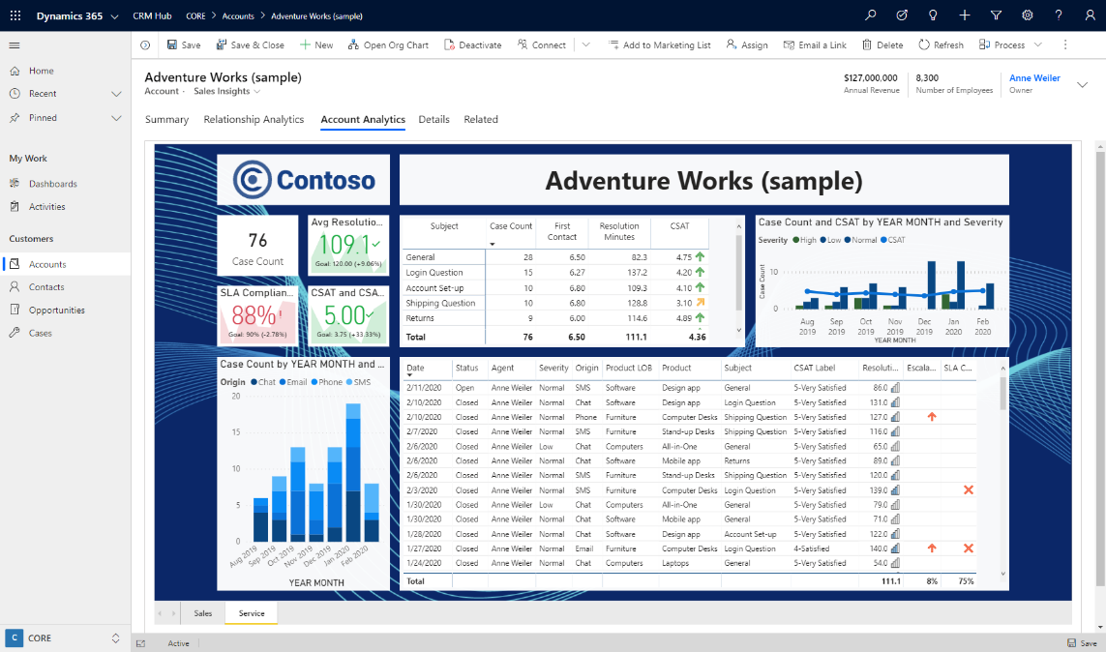
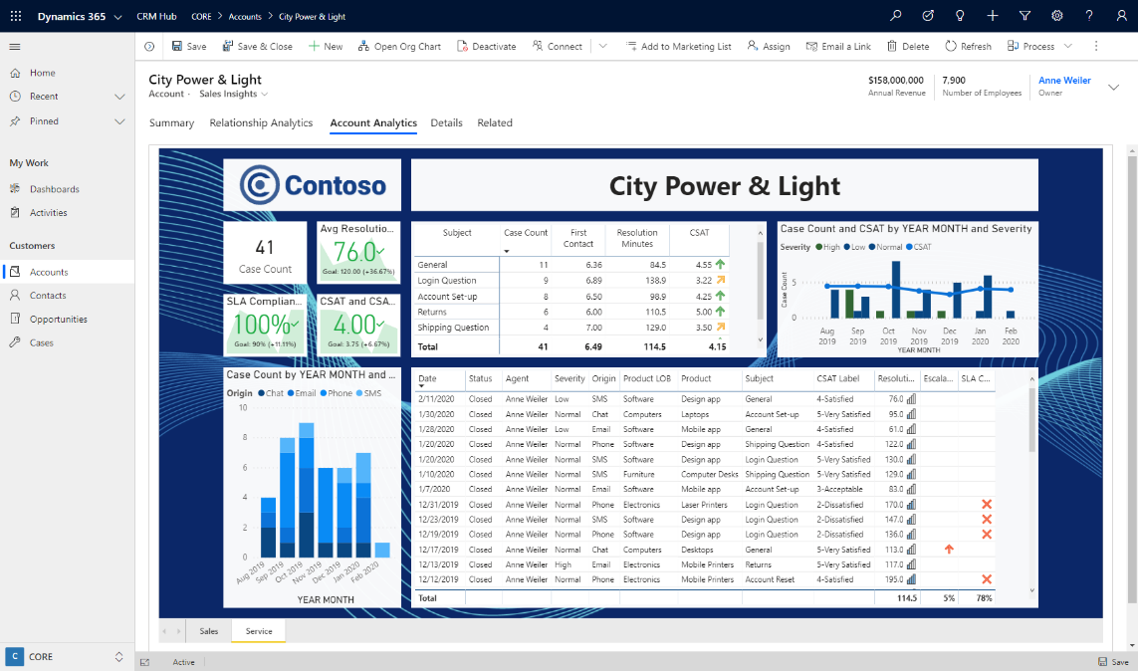
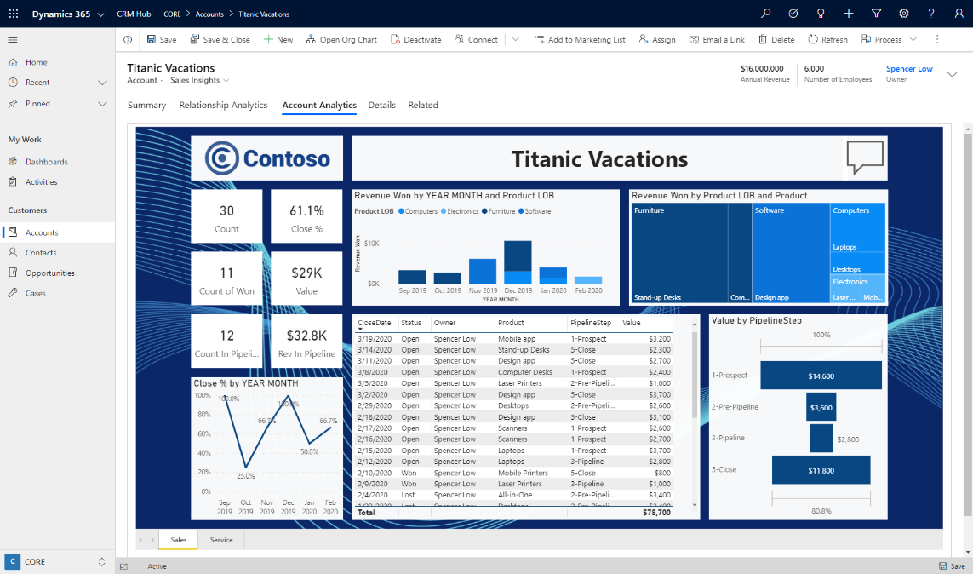
Show Me
Interactive Visualizations
What-If Exploration
No Code AI
Ask Questions, Get Answers
KPIs and Time Series Charts
Analytics on Entity forms

Slide 12
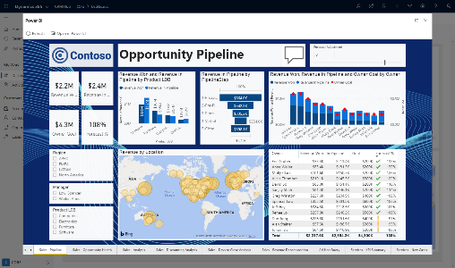
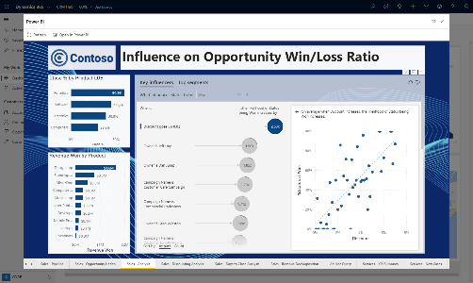
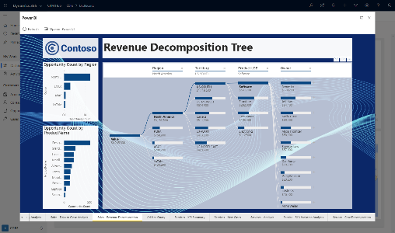
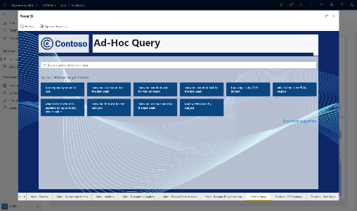
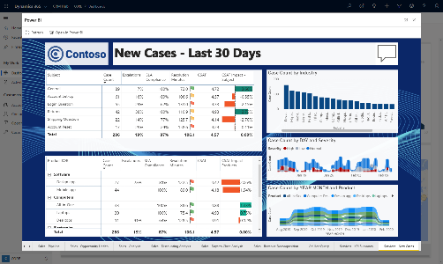
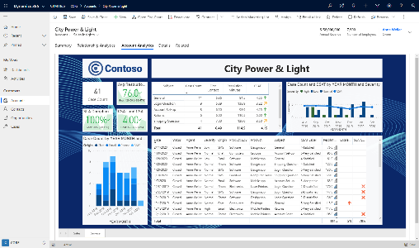
Show Me
Interactive Visualizations
What-If Exploration
No Code AI
Ask Questions, Get Answers
KPIs and Time Series Charts
Analytics on Entity forms

Slide 13

Challenges for Dynamics Technical Specialists
Limited time for builds
Focus is on Dynamics products
Building a realistic dataset is a challenge
Volume
Variety
Interrelatedness
Reloading data in volume is a waste of time

Slide 14
PowerBI Demo Assets for Dynamics Technical Specialists
14 Pre-Built Reports
6 Sales Reports
5 Customer Service Reports
1 Natural Language Query Report
2 Contextual Reports for Accounts
Excel Demo Data File
Modeled on CDS data structure
Formula Driven for Flexibility
Customizable Templates
Re-skin and add Customer Logos
Add/Remove Reports or Visuals
Re-label with Customer’s Terms
Accounts
+ Campaigns, Products, Users, Industries, Territories, etc.
5,000 Opportunities
Contacts
10,000 Service Cases

Slide 15
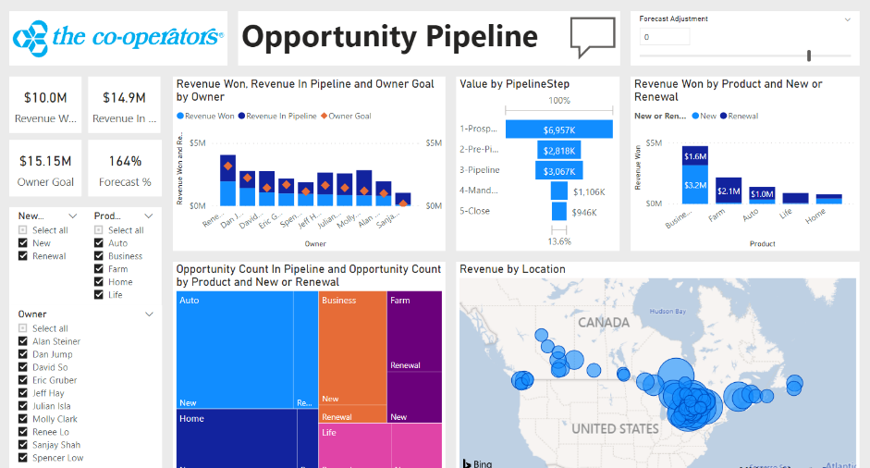
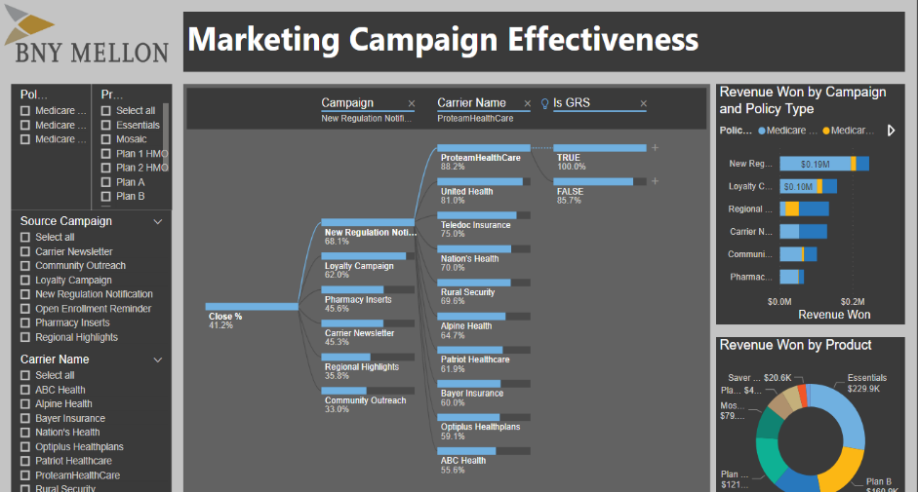
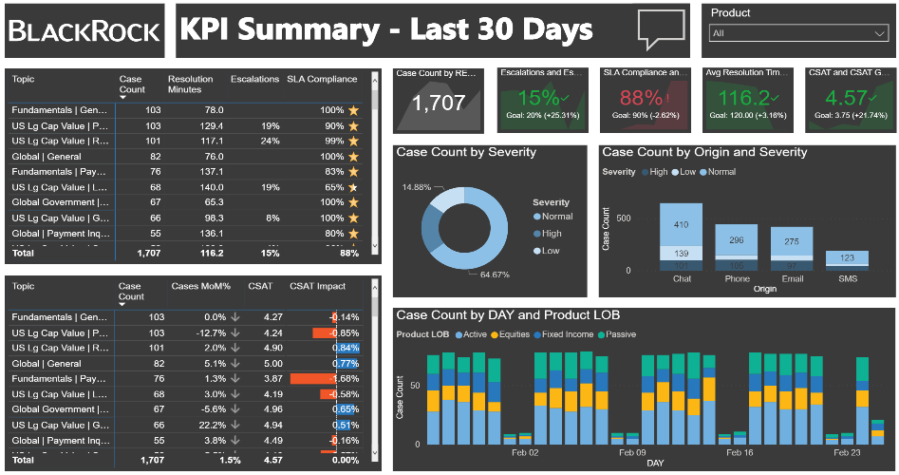
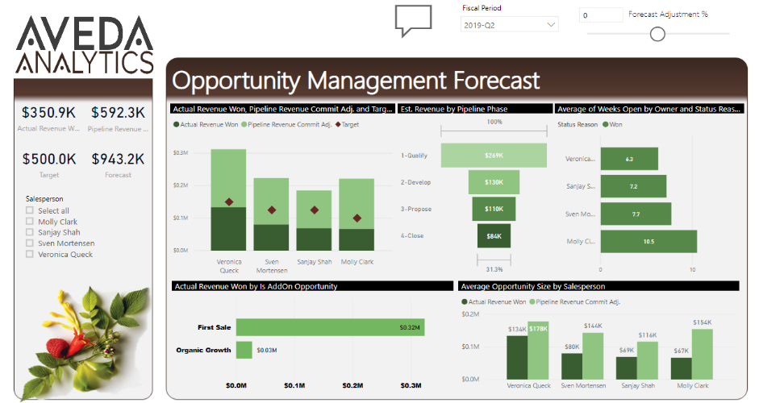

Slide 16
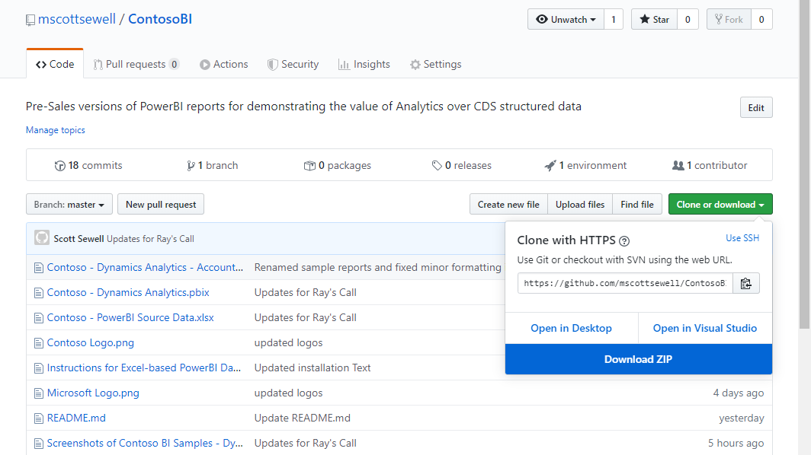
Demo Assets for Dynamics Technical Specialists
https://github.com/MScottSewell/ContosoBI

